Slide 1
NHS Pension Scheme 2015
Presentation prepared by Willie Duffy, Lead Officer (Pensions)
Notes:
Welcome
Intros
This presentation is to let you know what is happening to the NHS scheme from 2015 so that you are aware of the forthcoming changes and are able to give basic information to members.

Slide 2
What is changing?
From 1 April 2015, the current NHS superannuation scheme will be closed and members will move to a new scheme, referred to as the “2015 Scheme”.
This is unless the member is in one of the protected categories. These categories are:
Active members who were within 10 years of their Normal pension age as at 1 April 2012. These members are fully protected and will not have to move to the new Scheme.
Active members within a further 3 years and 5 months of normal pension age as at 1 April 2012. This is what is known as the “tapered” protection period. These members will have some protection but, as the name suggests, it will taper off the further they are from the full protection period. The effect of tapered protection will be to delay the move to the 2015 Scheme and allow the member to continue accruing benefits under their previous Scheme provisions. (This will be explained more fully later on)
Notes:
Protection calculator on SPPA website for members to check when they move to 2015 section under “tapered protection”
Members who returned to 95 or 2008 sections within 5 years of 1 April 2012 will also be protected.

Slide 3
WHY IS THIS HAPPENING? Overarching changes across public sector pension schemes
New Pension Schemes in line with Hutton and Pension Act are being put in place across the public sector.
Formal Scheme Governance arrangements are being put in place
HM Treasury will have more financial control
Pension Regulator will have oversight
Notes:
Governance
The Bill will require all public sector pension scheme administrators to set up a properly constituted pensions board to ensure compliance with scheme regulations.
In addition there will be an advisory board similar to the Scottish NHS Pensions group currently in place to advise on policy which affects the scheme.
Controls
The Act also sets out a number of controls to ensure the ongoing financial sustainability of the schemes going forward. These controls include:
Ensure that the annual percentage increase or decrease in pensions in specified annually by HMT relating to either prices or earnings.
Cap on any future costs increases of costs to employers
The Act sets out the mechanism around how this will operate in practice and further details will be provided by Treasury. It will set a ceiling and a floor and within which costs will operate and will set out a process should costs go either above or below this ceiling or floor.
Determine methodology and frequency around scheme valuations
The provisions in the Act aim to protect ongoing financial sustainability of the schemes for the next 25 years.
The Pensions Regulator will have oversight of public service schemes and will issue codes of practice.

Slide 4
So how does the 2015 Scheme differ from the current NHS Scheme?
The 2015 Scheme will be different in a number of respects. But for the purposes of this presentation there are 3 fundamental differences worth highlighting immediately
Notes:
Scheme Design
The Act brings an end to the Current Final salary pension schemes . The new scheme will therefor be a CARE scheme. I will explain this further in a moment.
Normal pension age in the new 2015 scheme will be the same as a member’s individual state pension age as stated in Government Policy.
The “accrual rate” is the amount a pension is built up each year. In the 1995 section this is 1/80th of final salary x number of years contributed , in the 2008 section it is 1/60th of final salary x number of years contributed. In 2015 scheme it is 1/54th of each years earnings revalued each year. (Slide coming up with more detail l)
If a member stays in scheme each years 1/54th is revalued at a rate equal to the Consumer price index plus 1.5%.
If a member leaves the scheme and 2015 benefits become “preserved” these will be revalued at only CPI however if the member rejoins the scheme within 5 years all accrued benefits will be joined and again be revalued at CPI plus 1.5%
The Scottish Framework Document is available on the SPPA website and details the main provisions in the 2015 scheme.

Slide 5
1 – Normal Pension Age (NPA)
The current Scheme has two Sections:
The 1995 Section (which has an NPA of 60, or 55 for “special class” members) is awarded to certain members of the scheme in recognition of their type of employment. The status was abolished for members joining the scheme for the first time on or after 1 April 1995 and also for those members returning to pensionable employment on or after that date with a break in membership of any one period of 5 years or more.
The 2008 Section (which has an NPA of 65)
The 2015 Scheme will have an NPA which is equal to the member’s state pension age.
The state pension age for men and women is currently different. But from November 2018, state pension age for both men and women will be 65.
NPA in the 2015 Scheme will therefore follow that same trajectory
If you want to know what your state pension age is currently, there is a calculator on the www.gov/uk website.

Slide 6
2 – The way in which pensions are calculated
The Current Scheme is “final salary” meaning pensions are based on the members salary at, or close to, retirement.
This could be your best year’s pensionable pay in the three years leading up to retirement (as in the 1995 section) or the average of the best three consecutive years in the 10 years leading up to retirement (2008 section).
The 2015 Scheme will be a “Career Average Revalued” or “CARE” Scheme”, meaning pensions are calculated based on a method which takes account of earnings over an entire career.
(This will be explained more fully later)

Slide 7
3 – Accrual Rate
Put simply, the accrual rate is the amount of pension benefit which a member receives for each year of active membership in the Scheme, expressed as a fraction.
In the current Scheme, the 1995 and 2008 Sections have different accrual rates
In the 1995 Section, the accrual rate is 1/80th
In the 2008 Section, the accrual rate is 1/60th
What this means is that the member receives (depending on which section they are in) either 1/80th of 1/60th of their “Final Salary” sum for each year of active membership they have in the Scheme.
In the 2015 Scheme, the percentage and methodology are both different.
In the 2015 Scheme, the accrual rate is 1/54th
Because the 2015 Scheme is a CARE Scheme, the member receives 1/54th of any given year’s pensionable earnings as part of their pension.
Each year, this 1/54th is added to the member’s pension pot and that pension pot is then “revalued” at the official rate of Consumer Price Index (CPI) inflation, plus 1.5%, each year until retirement.

Slide 8
The CARE Scheme explained in more detail
How much pension will I earn each year in the 2015 Scheme?
As mentioned earlier, the “accrual rate” in the 2015 NHS Scheme is 1/54th.
So if you earned £18,000 in a year you would earn a pension for that year of £18,000 x 1/54 = £333.
Each year’s pension pot is revalued then added together at the end of a career to become the final annual pension

Slide 9
CARE cont…
How is each year’s pension revalued?
In the 2015 NHS Scheme the revaluation is Consumer Price Index (CPI) inflation plus 1.5% per year.
The pension earned in a Scheme year (April to March) is revalued on the first of April of the following Scheme year and each subsequent Scheme year until you retire or leave. For example, if CPI inflation in a year was 2% then CARE pension would be revalued by 3.5% in the following year.
If you leave the 2015 NHS Scheme before becoming entitled to claim your retirement benefits (i.e. before your NPA), your CARE pension would continue to be revalued each year until benefits became payable – but only by the CPI rate (i.e. not by CPI plus 1.5%, as for active members)

Slide 10
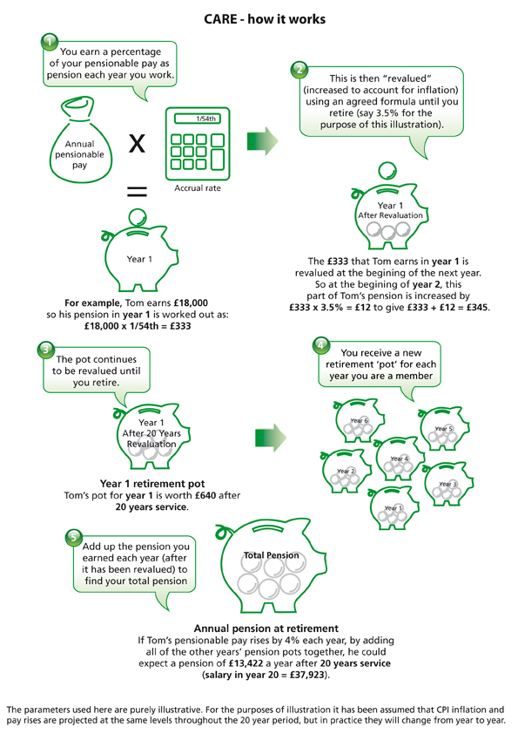

Slide 11
Other Features of Proposed NHS Scheme from 2015 (continued)
Early and late retirement factors
Draw down available as 2008 section
Additional Pension facility
Optional lump sum commutation at rate of £12 of lump sum for every £1 per annum pension given up
Ill health pensions based on current arrangements but upper tier based on enhancement of 50% of prospective service to normal retirement age
Lump sum on death in service 2 x actual pensionable pay
Abatement same as post 1 April 2008 arrangements
Notes:
Other features of the 2015 Scheme are the same as current 2008 section
The criteria for assessing ill health benefits will remain the same but the enhancement given to those qualifying for upper tier (assessed as not only not being able to do own job but unable to do any other job of similar duration) changes to 50% of prospective service to normal retirement age.

Slide 12
Am I protected?
Those who are fully protected (within 10 years of NPA as at 1 April 2012) will not have to move to new 2015 scheme
Those who are between 10 years and 13 years 5 months from their NPA at 1 April 2012 will have “tapered” protection, but will have to move to 2015 scheme when this protection ends
Tapered protections works by subtracting 2 months from the 10 year protection period for every month beyond 10 years a member is from their NPA.
So, for instance, a member of the 95 Section who has a NPA of 60, and whose 48th birthday was 1 April 2012, would be 2 years ( or 24 months) beyond the full protection period.
As the full protection period will end on 31 March 2022, this member’s protection would end 4 years (or 48 months) before that point. They would therefore move to the 2015 Scheme on 1 April 2018
Every one else will move to 2015 scheme from 1 April 2015
Notes:
Tapered protection
For each month beyond 10 years from npa at 1 April 2012 the protection period is reduced by 2 months
Tapered protection calculations are available on the SPPA website
Protection will be lost if a member leaves the scheme after 1 April 2012 and does not rejoin the scheme within 5 years.

Slide 13
What about Benefits I’ve already accrued in current scheme?
Benefits accrued will be “preserved”
Linked to final salary at time of leaving 2015 scheme
Can be taken at old scheme NPA, but must retire from NHS employment
If 1995 section benefits taken cannot rejoin 2015 scheme
2015 benefits can be taken at same time but will be actuarially reduced.

Slide 14
“Choice”
A second “choice” exercise will take place after 1 April 2015
Members in the 1995 Section will be given a second chance to move to the 2008 Section, on the basis that those members may have made a different choice had they been aware of the changes which the Pensions Act would bring about.
Those eligible:
Do not have full protection
Were eligible at last exercise
Further information will be issued in due course.

Slide 15
Opting out of Protection
Analysis suggests that some members of the 2008 Section of the existing Scheme would be better off moving to the 2015 Scheme immediately on 1 April 2015, rather than staying in the previous Scheme for the protection period.
Members in the 2008 Section will therefore be given a choice to opt out of protection and move direct to 2015 section
This exercise will take place after 1 April 2015
There is no overlap between those in the 1995 Section who are eligible for the second “choice” exercise and those in the 2008 Section who are eligible to forgo protection. No-one will therefore be in the situation of having to make two choices.
Further details available in due course

Slide 16
Where can I get further information?
SPPA website - Framework Document, FAQ, Protection calculator and other docs to be added as developed www.sppa.gov.uk
email nhspensionsreform@sppa.gsi.gov.uk
Trade Unions
Professional organisations
HR Managers

